Slide 1

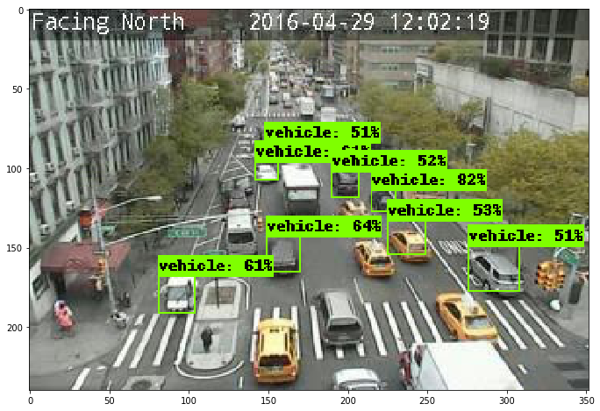
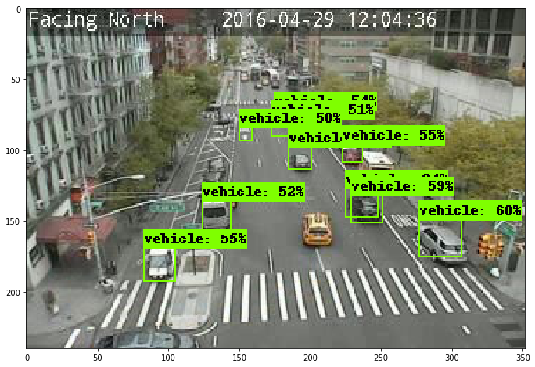
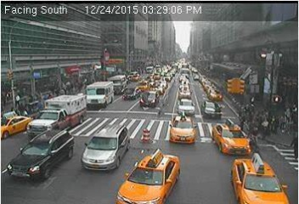
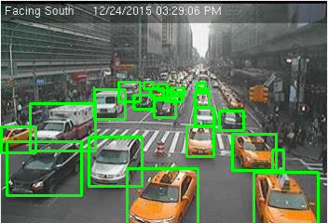
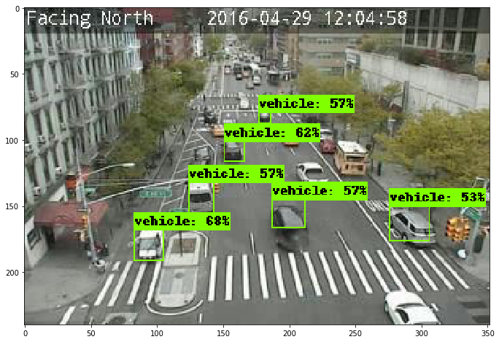
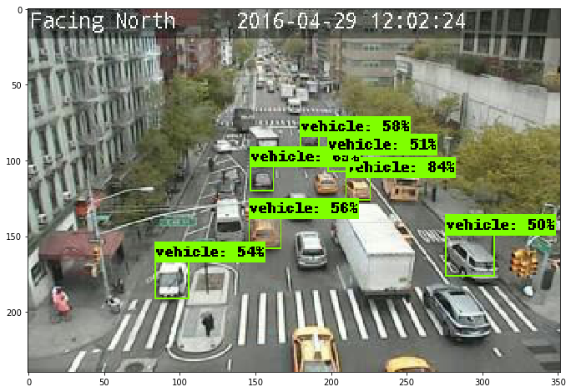
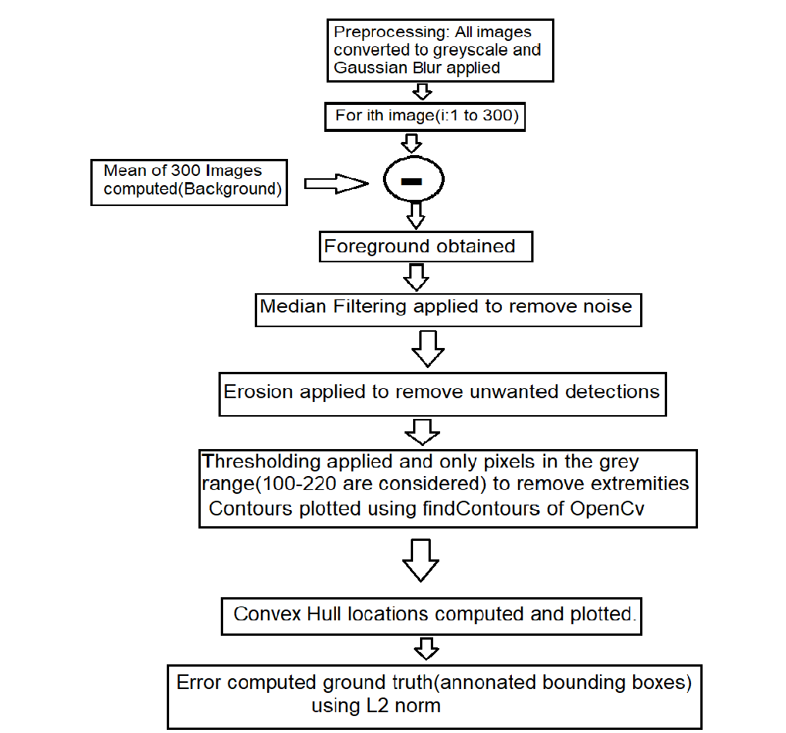
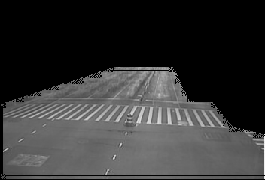
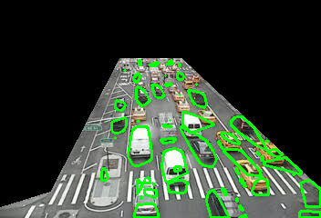
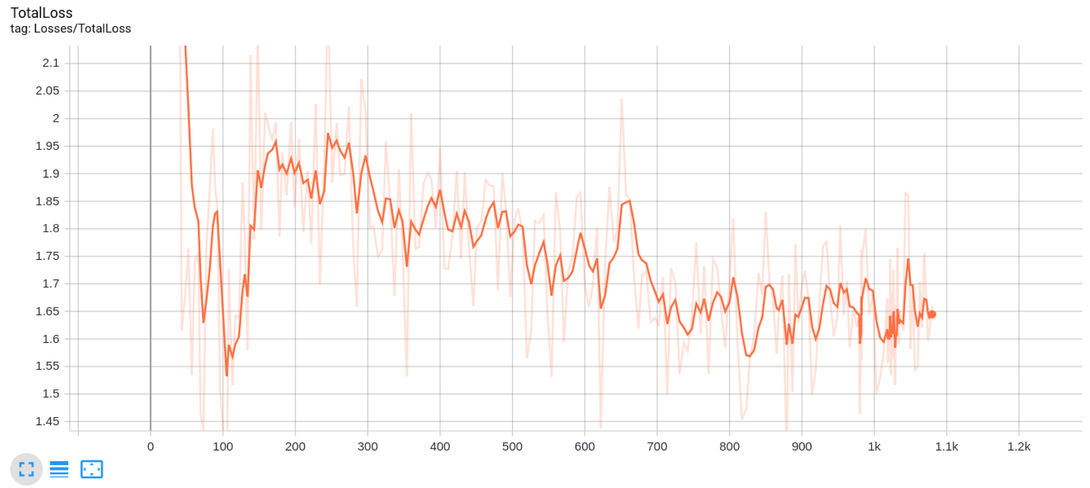
Extracting Traffic Data using Computer Vision Techniques
Members - Jai Mahajan (2016154), Aditya Aggarwal (2016127)
Project Title & Motivation
Dataset Description
Interpretation of Results
In a city like Delhi where the increase in the number of vehicles on the road is never ending, it is required to intelligently control Traffic Signals to avoid unnecessary traffic jams or give priority to the sides having emergency vehicles. Even in the presence of Traffic police some of the road junctions in peak hours become very chaotic and are tough to manage. In such cases sometimes one notices the policeman guiding the traffic and giving priority to the side with high traffic. This is where computer vision can help in understanding traffic density which in turn will help in creating an automated system for monitoring traffic at a signal and regulating the signals accordingly.
We used the CityCam dataset [4] prepared by a CMU team which got introduced in the CVPR 2017 IEEE CVPR conference [1]. The dataset
contains frames taken from 212 traffic cameras installed across Manhattan. The camera’s have a frame rate of 1 frame/sec and resolution 352x240.Information of the weather, bounding boxes, types of vehicles, vehicle density is annotated.
The morphological approach was unable to beat the fast RCNN method even with limited training(around 1000 iteration) in terms of the number of false negatives. The accuracy was more in the deep learning approach as compared to the morphological approach. Increasing the the number of training iterations also significantly improved the performance.
Problem Statement
The aim of this project was to make a Computer vision model capable of assessing detecting vehicular density given an image frame which could be used to adjust the traffic signal durations. The problem statement for the project boils down to detecting vehicles in a given frame.A common object detection algorithm would detect vehicles frame by frame by applying the same algorithm on each frame. The problem could also be formulated as a tracking problem but for the dataset that we have chosen, the Lucas-Kanade optical flow tracker can not be implemented because the sampling frequency is 1Hz (1 sample per second) which violates the small motion assumption of the lucas kanade detector.
Existing baseline for problem/dataset
The base paper[2] has reported an accuracy of 96%. The method used to calculate accuracy was number of vehicles detected divided by the total number of vehicles. This metric may not be a suitable indicator of performance hence we consider the deep learning paper[5] which reports performance with a mean absolute error of 2.1 between the bounding boxes.
Conclusion
Proposed Algorithm/Results Obtained
We achieved visually good results especially in the morphological approach.The Deep learning approach was very accurate in terms of the correct detections. If trained for a longer time the model would have reduced the False Negatives.There were many issues we faced and observed. Some of them included the fact that the image quality in the dataset was very low, The model we developed was not robust to densely placed vehicles and could not distinguish between a car which was far or a nearby pedestrian in the morphological approach. We would like to in future applying better techniques like using GPU for training, fine tuning hyperparameters,etc for reducing the error.
Method1: Morphological approach
Literature Review
Various methods have been developed for the problem of traffic density estimation. These methods range from detection based methods, motion based methods, holistic approaches and deep learning based methods. We have chosen the state of the art paper which takes into account the drawbacks of previously existing methods. We can also use upcoming methods like dictionary learning and convolutional sparse coding apart from the commonly used learning algorithms like CNN.Broadly the following approaches were used-
Image processing based approaches(Background subtraction,Image Morphology,Edge Detection)
Sparse representation based approaches(CSC)
Deep Learning based approaches (CNN,RCNN,FCN)
Method2: Loss function for the deep Learning approach using tensorflow (Fast RCNN)
References
Understanding Traffic Density from Large-Scale Web Camera Data - https://arxiv.org/abs/1703.05868
A computer vision based vehicle detection and counting system - https://ieeexplore.ieee.org/document/7440510/metrics
Automatic Traffic Using Image Processing - https://www.scirp.org/journal/PaperInformation.aspx?PaperID=78431
CityCam-CMU Dataset - https://www.citycam-cmu.com/
5. Dictionary learning based object detection and counting in traffic scenes - https://dl.acm.org/citation.cfm?id=1865995
6. FCN-rLSTM: Deep Spatio-Temporal Neural Networks for Vehicle Counting in City Cameras https://deeplearn.org/arxiv/12232/fcn-rlstm:-deep-spatio-temporal-neural-networks-for-vehicle-counting-in-city-cameras
Notes:
‹#›

